Slide 1


Accelerate Cloud Native Development
with Coder
Coder.com

Slide 2
Logistics
Just a few minutes of slideware (I promise)
Hands on exercises, get out your laptop
Log into GitHub
Login to devweek.demo.coder.com with GitHub
If you’re stuck just raise your hand
Demos focused on Coder Open Source
Environment available all week
Docker-based, any materials from today will work on a local quick install
Slides/code/examples available on GitHub
Coder.com

Slide 3

Tim Quinlan
Senior Technical Marketing Manager,
Coder
Coder.com

Slide 4

Coder.com
Notes:
Raise your hand if:
If you maintain a wiki for your devs so they can set up tooling
If you have non-developers users using somewhat devy tooling (docs pipeline, data science, etc) If you switch back and forth between projects that use different tooling
It takes more than 5 minutes to deploy complete tooling to a new developer

Slide 5
Coder (the company) Overview
Open Source Software provider in the developer segment
Austin, Texas
Ever growing list of projects (github.com/coder) including code-server (64k GitHub stars)
Founded in 2017, generally available software since 2020
Coder.com

Slide 6
Coder (the software) Overview
Runtimes have moved to the cloud
Developers deserve a fully supported Cloud Development Environment too :)
Reduce time lost to environment setup/maintenance
Code securely on any device
Code in a standardized environment
Coder.com

Slide 7
Coder Differentiators
100% Open Source (even paid features)
Self-hosted, you choose the infrastructure: host-based, container-based, on-prem, public, even air-gapped
Multi-region and multi-cloud
Works with most IDEs and source control
Persistent homes
Fully supported Platform Engineering solution
Coder.com

Slide 8
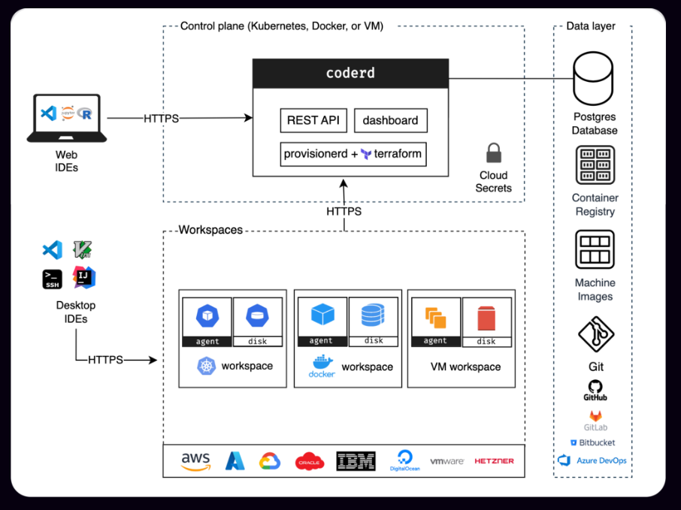
Coder Architecture
Coder.com

Slide 9
UI and Workspace Overview:
Quick tour of a template, context only
Quick tour of the Web UI, just enough to get started
Quick tour of the workspace, just enough to get coding
☠☠☠ Coder anti-pattern ☠☠☠
You have sudo for a reason
The reason is not to make snowflakes
Coder.com

Slide 10
Demo Scenarios:
I am the Platform Engineer, you are the developers
We’ll walk through increasingly awesome uses of Coder
Coder.com

Slide 11
Demo Scenarios:
Log into devweek.demo.coder.com
Create a workspace from the DevWeek Base template
Coder.com

Slide 12
Demo - Deploy Dev Tooling:
Deploying tools with startup_script
Deploying tools with built in Dockerfile
Deploying tools with a custom image
Deploying tools with modules
There is no “right way” do what works best for you (except creating snowflakes)
Coder.com

Slide 13
Demo - Test a webapp:
Source code is automatically pulled or cloned
Start the webapp, see it open a port on the Workspace, open in browser
Coder.com

Slide 14
Demo - Alternate Project Tooling:
Create a workspace from VS Code Web and Copilot
What is different on the Workspace?
Launch VS Code Web
Notice different plugin that would conflict with the plugin from other Workspace
Leave both Workspaces open and context switch like a boss
Coder.com

Slide 15
Demo - Write Some Code:
Write some code!!
Both workspaces have an AI plugin
Coder.com

Slide 16
Install Coder Today:
Quick install
$ [start dockerd]
$ curl -fsSL https://coder.com/install.sh | sh
$ coder server
$ curl localhost:3000
Coder.com

Slide 17
Summary
Self-hosted Cloud Development Environment
Developers use consistent and familiar tools
Admins control the data and the platform
Developers can create workspaces with a few clicks
Anti-pattern: empirical software install
Patterns: declarative software install, idempotent start-up, coder_apps
Coder.com

Slide 18

Q&A
Coder.com

Slide 19
coder.com
@coderhq
github.com/coder
discord.gg/coder
tim@coder.com
@trquacker
timquinlan/devweek24
Coder.com

